Slide 1
BARNGA ADAPTATION
Adapted by Dr. Kris Acheson-Clair, CILMAR, based on the following:
Thiagarajan, S. & Thiagarajan, R. (2006). Barnga: A simulation game on cultural clashes. Intercultural Press.

Slide 2
BARNGA ADAPTATION
Instructions (Part 1)
Divide into groups.
Each group gets a deck of cards and each participant a rule sheet.
Note: You will be practicing nonverbal communication, so make sure you get comfortable with the rules of the game in the first round because afterwards you will “going silent.”
Take a few minutes to learn the rules and play a practice round with your group.

Slide 3
BARNGA ADAPTATION
Instructions (Part 2)
Now that you have finished your practice round, hand in your rule sheets.
Play the first official round of the game.
The round is over when one group member loses all their cards.

Slide 4
BARNGA ADAPTATION
Instructions (Part 3)
Now, switch up the groups.
Each group once again gets a deck of cards and each participant a rule sheet.
Remember that there should still be no written or spoken communication of any kind. You can only use gestures to make declarations, ask or answer questions, and negotiate conflict.
Play another round of the game with your new group members.

Slide 5
DEBRIEF
How did you feel at different points in the game (e.g., when the rules were first explained, when the rule sheets were taken away, in your first group, in your second group)? Did your feelings change throughout the different stages?
What were some successes and, conversely, some frustrations/problems that occurred as you were playing?
Why do you think those frustrations/problems occurred while you were playing? What were the underlying causes?

Slide 6
THE BIG REVEAL
A majority of the members in each group had one set of instructions while a minority of members had a different set!
…..Did you figure it out?

Slide 7
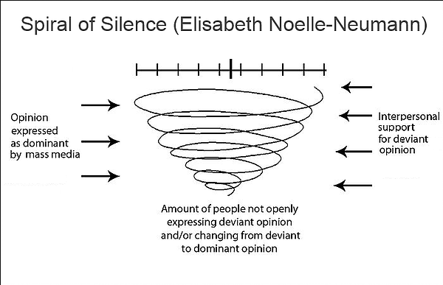
THE SPIRAL OF SILENCE THEORY
This theory demonstrates how minority viewpoints get suppressed by majority/popular opinion.
Image found at https://iratisaenz.wixsite.com/makesomenoise/single-post/2015/02/09/The-Spiral-of-Silence

Slide 8
DEBRIEF (CONTINUED)
If you were a member of the majority in your group, how did you feel? How did you handle conflict?
If you were a member of the minority in your group, how did you feel? How did you handle conflict?
How does this activity translate to “real life” situations?
Have you ever been in a “real life” situation where there was a majority/minority conflict? What was it like?
What did you learn about communication and conflict after playing this game?
What did you learn about minority experiences after playing this game?

